Slide 1
An Overview of the Regenstrief Center for Healthcare Engineering
Md. Adibuzzaman and Paul Griffin
June 5, 2018

Slide 2


(established in 1969)
Regenstrief Foundation
(established in 1967)
(established in 2006)
Notes:
Mention that we were renewed on Tuesday.

Slide 3
Cross-cutting Centers
Bindley Bioscience Center
Birk Nanotechnology Center
Burton D. Morgan Center for Entrepreneurship
Purdue Center for the Science of Information
Purdue Policy Research Institute
Impacting Global Health
Purdue Institute of Inflammation, Immunology and Infectious Disease
Purdue Institute for Integrative Neuroscience
Purdue Institute for Drug Discovery
Regenstrief Center for Healthcare Engineering
Women’s Global Health Institute
Impacting Global Sustainability
Center for Global Food Security
Center for the Environment
Energy Center
Purdue Climate Change Research Center
Impacting Global Security
Institute for Global Security and Defense Innovation
VACCINE
Tomás Diáz de la Rubia
Director
Suresh Garimella
EVPR
Notes:
We are unique in that our costs are covered by Foundation (no cost to Purdue) and PHA completely covers salaries, and I technically have four direct reports (Suresh, Tomas, Abhi Deshmuk, and George Wodika). Note that Suresh also sits on the board of the Foundation.

Slide 4
Purdue Healthcare Advisors (PHA)
33 Employees; outreach arm of RCHE; 3 service lines:
Quality reporting, IT security, Lean/agile implementation
Funding: CMS, state agencies, providers
Center faculty and research scientists
10 full time staff, faculty, and research scientists;
IE, CS, statistics, mathematics
Funding: NIH, NSF, foundations, providers, etc.
Affiliated faculty and clinicians
Faculty from colleges of Agriculture, Engineering, Health and
Human Sciences, Management, Pharmacy, and Science

Slide 5
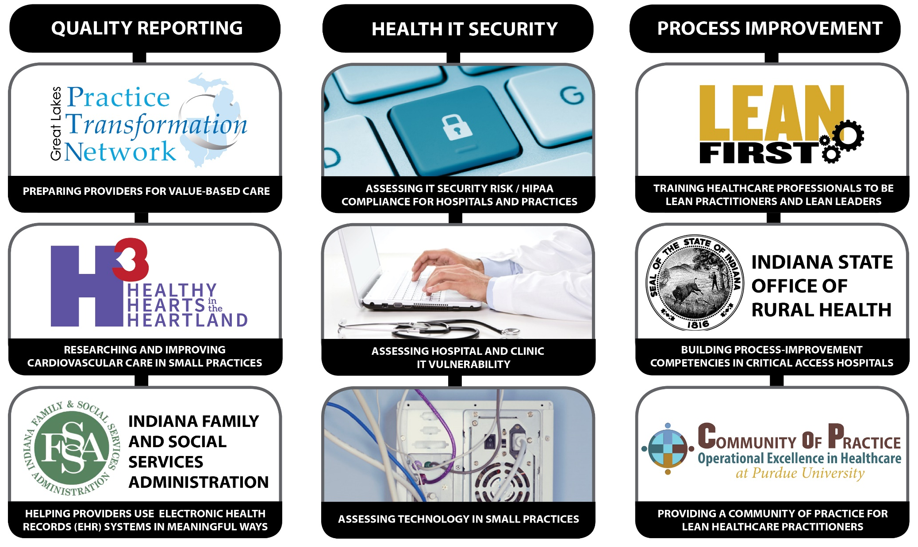
Purdue Healthcare Advisors (PHA)

Slide 6
PHA Intent – Research Access/Dissemination
Healthcare Providers
Needs
PHA
Access/
Dissemination
Purdue Research
Healthcare providers have many unresolved complex issues
PHA has access, innovation, and dissemination capacity throughout IN
RCHE can bring to bear Purdue’s intellectual/ research/innovation capabilities
PHA established this type of relationship with Northwestern University (Healthy Hearts in the Heartland $15M grant) and the IU School of Medicine ($50M Practice Transformation Network proposal).

Slide 7

Health Analytics - Developing data science-based approaches to personalized care
Overview
Clinical and operational decisions should be based on the best
available evidence, although this may depend on patient and context
characteristics as well as judgement of the clinician. As the ability to collect
and process large amounts of digital data continues to expand rapidly, it is
becoming possible for healthcare organizations to develop an evidence base
that links process activities to patient and population outcomes. We are
addressing this challenge by developing readily accessible databases,
visualization tools, sensors, and patient monitoring into a structure that
provides actionable information – bridging the gap between data and evidence
generation for clinical knowledge translation.
Current Examples
Framework software for integrated data-driven reproducible research to support healthcare delivery
Risk stratification for atrial fibrillation
A real-time drug response tracking system for precision medicine for pediatric sepsis
Causally-driven healthcare science
Prediction of intravenous medication use error after concentration change

Slide 8

Capacity Management – A systems approach to matching health resources to need
Overview
Healthcare organizations often “sub-optimize” their delivery by focusing improvement efforts on a particular component of their system without properly considering the complex set of interactions with other system components. Demand on the system is typically highly variable, uncertain, and out of the direct control of the provider. Misaligned incentives can result from ill-designed reimbursement structures for care providers, undue focus on the affordability of medications, and a system focused on treating the sick rather than maintaining health. As healthcare has moved from a fee-for-service to capitated model, controlling costs has become one of the most important drivers in the industry. We are developing approaches to properly match health resources (capacity) with health need.
Current Examples
Improving health outcomes and efficiency in chronic obstructive pulmonary disease
Optimizing trauma care network design
An HIT-enabled community-wide approach to opioid treatment
Engineering Kangaroo Mother Care
Cost effective quality care for long-term care Medicaid patients

Slide 9

Rural/Global Health – Improving access to care for vulnerable populations
Overview
Behavioral and social factors, along with genetic predisposition are major determinants of health and wellness. Moreover, in order to make interventions more coordinated, tailored, timely and sustainable, there will be a shift to more virtual care with less dependence on clinical care solutions. We are working to improve the health and wellness in rural communities, including global settings, by identifying opportunities (e.g., “at risk” populations), determining how to best target interventions, characterizing spread of a condition through a community, fostering technology adaption and the appropriate use of eHealth, mHealth, telehealth, and point of care diagnostics.
Current Examples
Non-invasive anemia detection
Mobile-based care for children with autism spectrum disorder using remote experience sampling method
Demand sensing to support maternal and newborn health
mHematology for care and management of sickle cell patients in sub-Saharan Africa
Modeling Return on Investment in Education and Home Visits for Medicaid-enrolled Children with Asthma
Highly-sensitive, low-cost paper-based molecular diagnostic platform

Slide 10

Structural causal models
“A problem that every scientist in every field faces is having observations from surveys, laboratory experiments, randomized trials, field studies and more, but not knowing whether we can learn from those observations about cause-and-effect relationships in the real world…with structural causal models, they can ask first if it’s possible, and then, if that’s true, how.”
Elias Bareinboim
Assistant Professor in Computer Science
Notes:
Bareinboim and Pearl developed a mathematical tool called a structural causal model, which essentially decides how information from one source should be combined with data from other sources. This enables researchers to establish properties of yet another source — for example, the population of another state. Structural causal models diagram similarities and differences between the sources and process them using a new mathematical tool called causal calculus.
The analysis also had another important result — deciding whether the findings from a given study can be generalized to apply to other situations, a century-old problem called external validity.
For example, medical researchers might conduct a clinical trial involving a distinct group of people, say, college students. The method devised by Bareinboim and Pearl will allow them to predict what would happen if the treatment they were testing were given to an intended population of people in the real world.

Slide 11
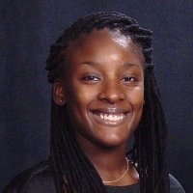
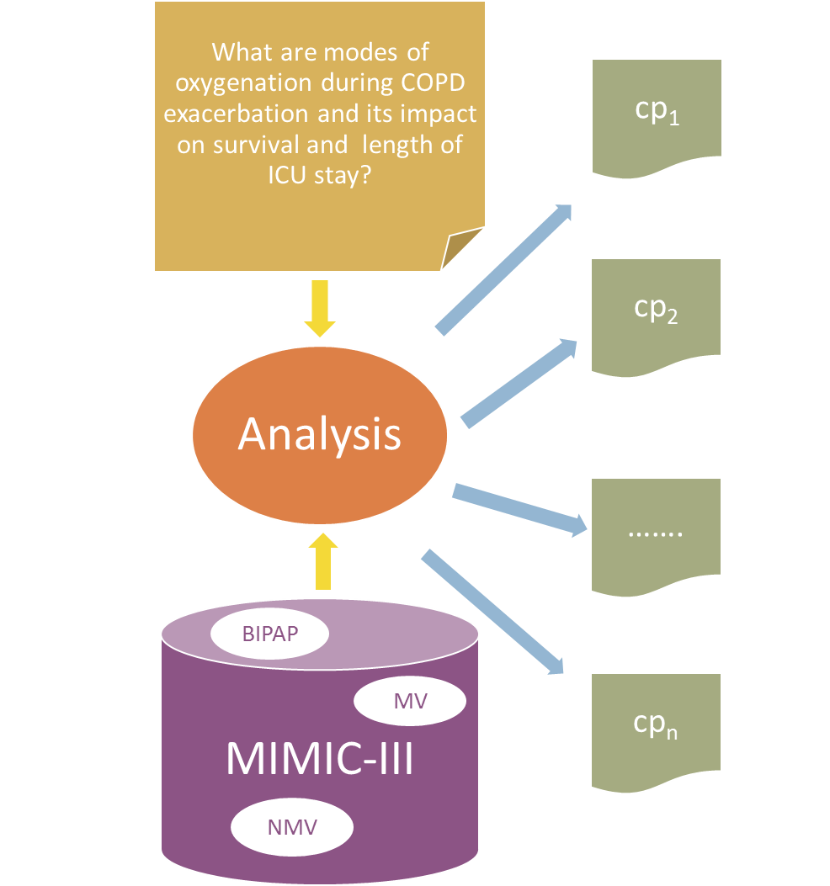
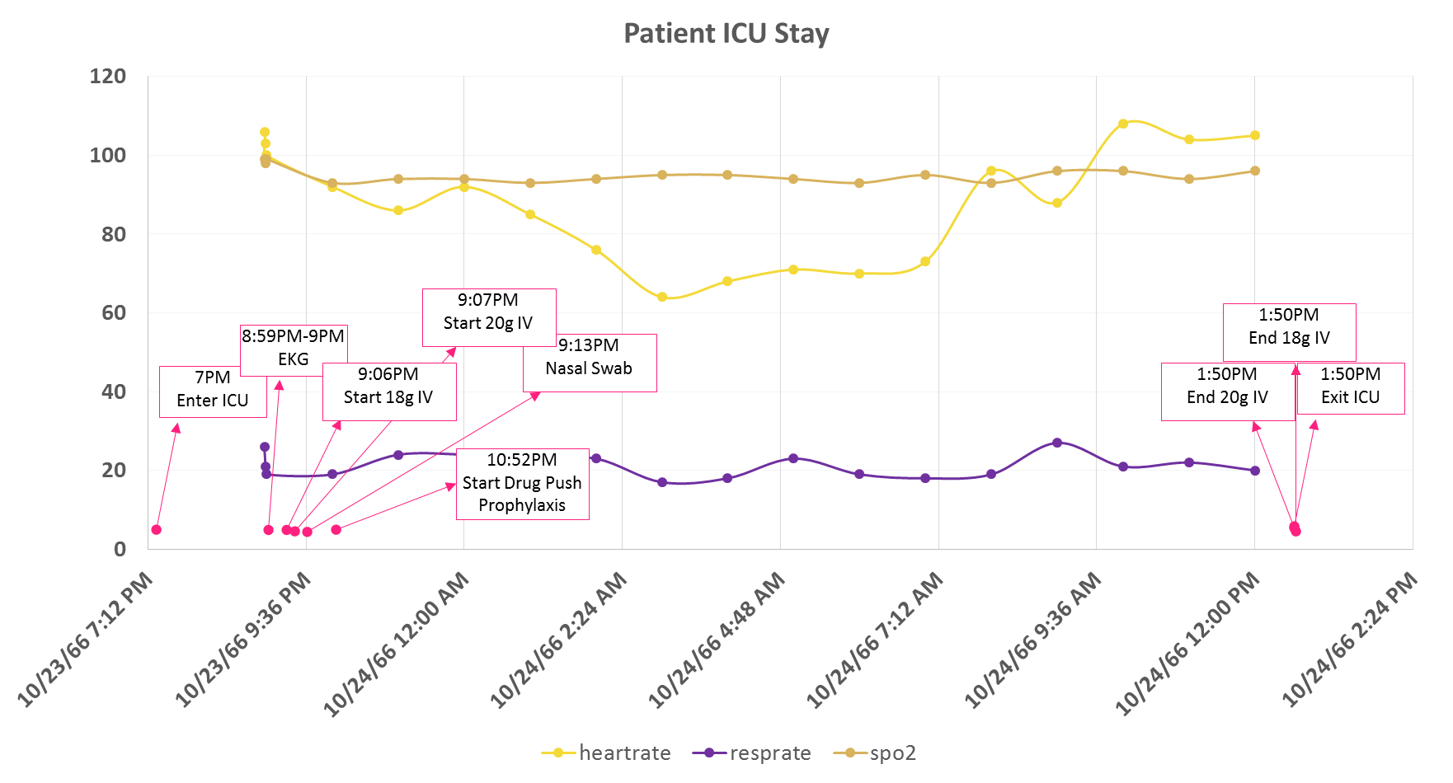
Personalized care pathways
Amber Johnson
PhD Student in Computer Science
Heart Rate
Sp02
Resp Rate

Slide 12
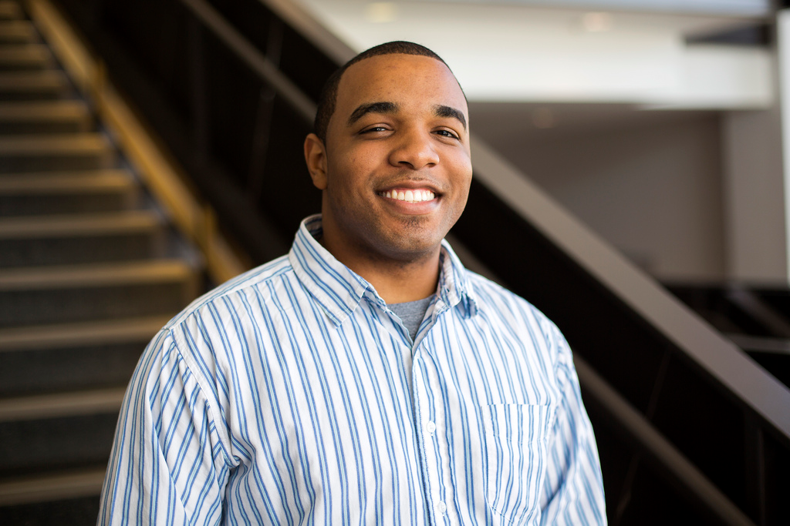
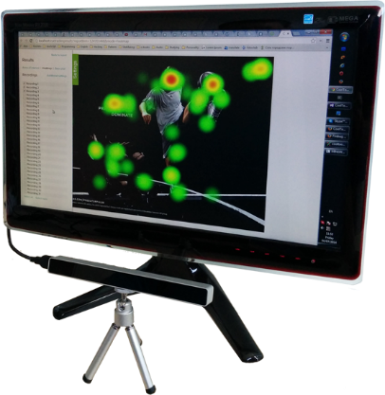
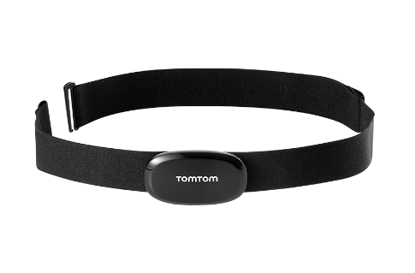
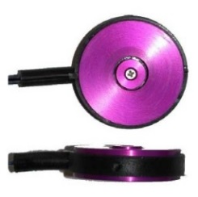
Aging in place
“I am working to develop improved designs that improve the performance of the elderly in complex environments (e.g., driving) and in interactions with daily technologies in the home.”
Brandon Pitts
Assistant Professor, Industrial Engineering

Slide 13

Importance of Information
“I examine how information problems affect individual behavior and the organization of firms and markets, especially the structure of those industries related to health care. In particular, how information affects long term care such as nursing home operations.”
Susan Lu
Assistant Professor, Krannert College of Management

Slide 14
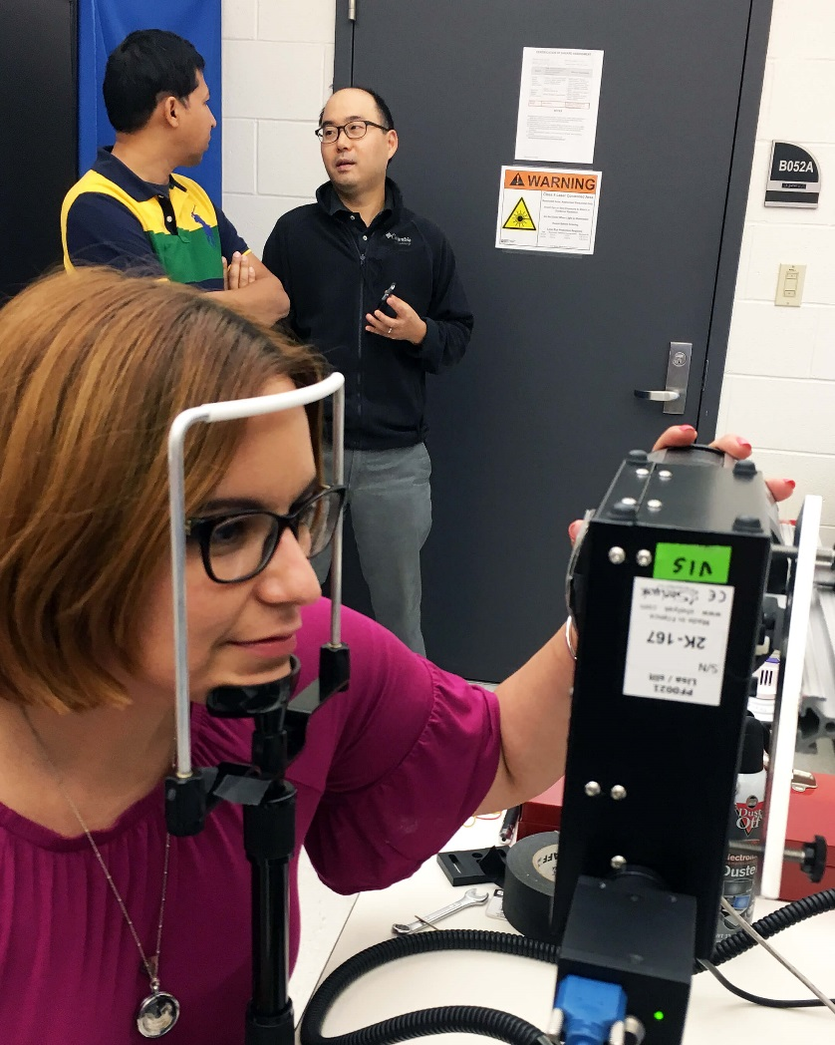
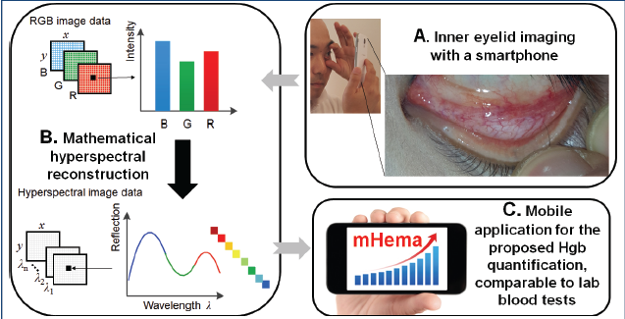
Mobile testing for anemia
“Sunny” Munril-Haque
Research Scientist, Regenstrief Center
Notes:
Anemia, a condition in which patients do not have enough healthy red blood cells to carry adequate oxygen to the body's tissues, is prevalent among cancer patients and likely related to the cancer itself, chemotherapy, radiation or blood loss. The creation of sHEA (smartphone-based bloodless spectrometerless HEemoglobin Analyzer) by Young Kim, associate professor with the Purdue Weldon School of Biomedical Engineering, and Md Munirul Haque, research scientist with the Regenstrief Center for Healthcare Engineering at Purdue, aims to make detecting this condition easier and more convenient.
“More than half the patients undergoing cancer treatment are likely to become anemic at some point in time,” said Kim. “The device we are developing has the potential to allow for earlier anemia detection, and it’s noninvasive, which is especially important for cancer patients who have greater sensitivities to needles as well as co-morbidities that cause problems with vein access.”

Slide 15
question
How do we use observational (and experimental) data for evidence based medicine?
Translation
Data Infrastructure

Slide 16
Translation: Causality from Observational Data

Slide 17
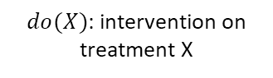
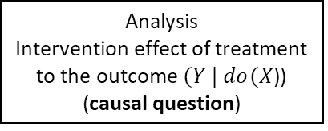
randomized control trial
effect of treatment /drug on outcome?”
Randomizing patients
To remove confounding bias
Demographic (age / sex / race)
Physiological (heart rate, etc.)
Sociological (income)
Case
(Treated, $X=1)$
Control
(Non-treated, $X=0$)
Analysis
Intervention effect of treatment to the outcome $(Y | do(X$)) (causal question)
$do(X)$: intervention on treatment X

Slide 18
Limitations of randomized controlled trial
Ethical/safety issues
Target patients are pregnant woman
Smoking / Non-smoking?
Limited samples
Limited number of patients.
Sampling bias
Cost
Time
Money

Slide 19
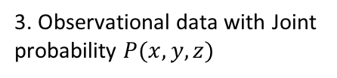
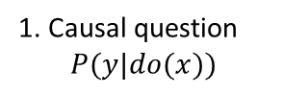
Alternative to rct: observational data
Question: Is it possible to find causal relationship given clinical knowledge and observational data?
1. Causal question
$$P(y|do(x))$$
Challenge
1. How to remove confounding bias in the model?
2. Model based on clinical knowledge
Z
Confounders
2. Which variables are needed and measured to analyze causal relationship?
Treatment
X
Y
Outcome
3. Observational data with Joint probability $P(x,y,z)$

Slide 20
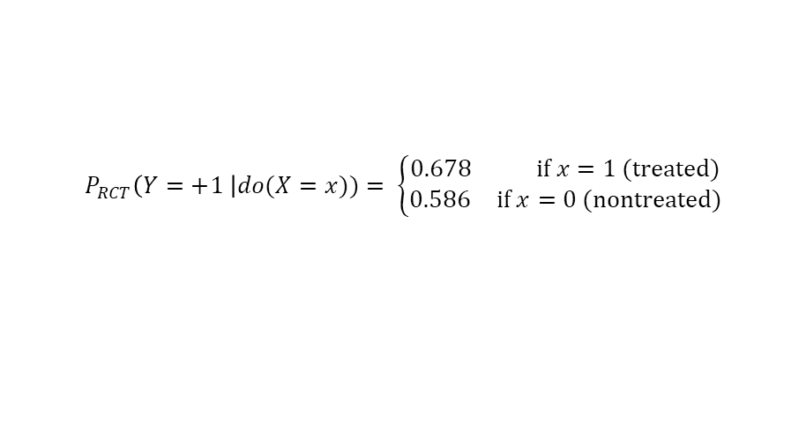
Example RCT: effect of neuromuscular blocker on ards mortality rate
Example study: Papazian et al., New England Journal of Medicine (2010)
Patients from ICU
We have medical data from ICU (MIMIC)
Z
Confounders
Patients demographical values (age, sex), mechanical ventilator setting values, chart values, critical condition, etc.
Randomization
𝘅
X
Y
Treatment
Cisatracurium besylate
(NMBA)
Outcome
ARDS
mortality rate
339 Subjects (177 case / 162 control) in ICU / 11 sites (France)
Conclusion
67.8% of subjects taken drugs survives (90 days)
58.6% of subjects not taken drugs survives (90 days)
$$P_{RCT}\left(Y=+1 \right|do(X=x))= \left\{\begin{aligned}0.678 \text{if} x=1 (treated) \\ 0.586 \text{if} x=0 (nontreated)\end{aligned}\right.$$

Slide 21
Initial study results

Slide 22
Population Scale Longitudinal Data Analytics in Healthcare
By: Amber M. Johnson
Notes:
This is an interdisciplinary project
Talk about multidisciplinary team.
The aspect I’m going to focus are ….

Slide 23
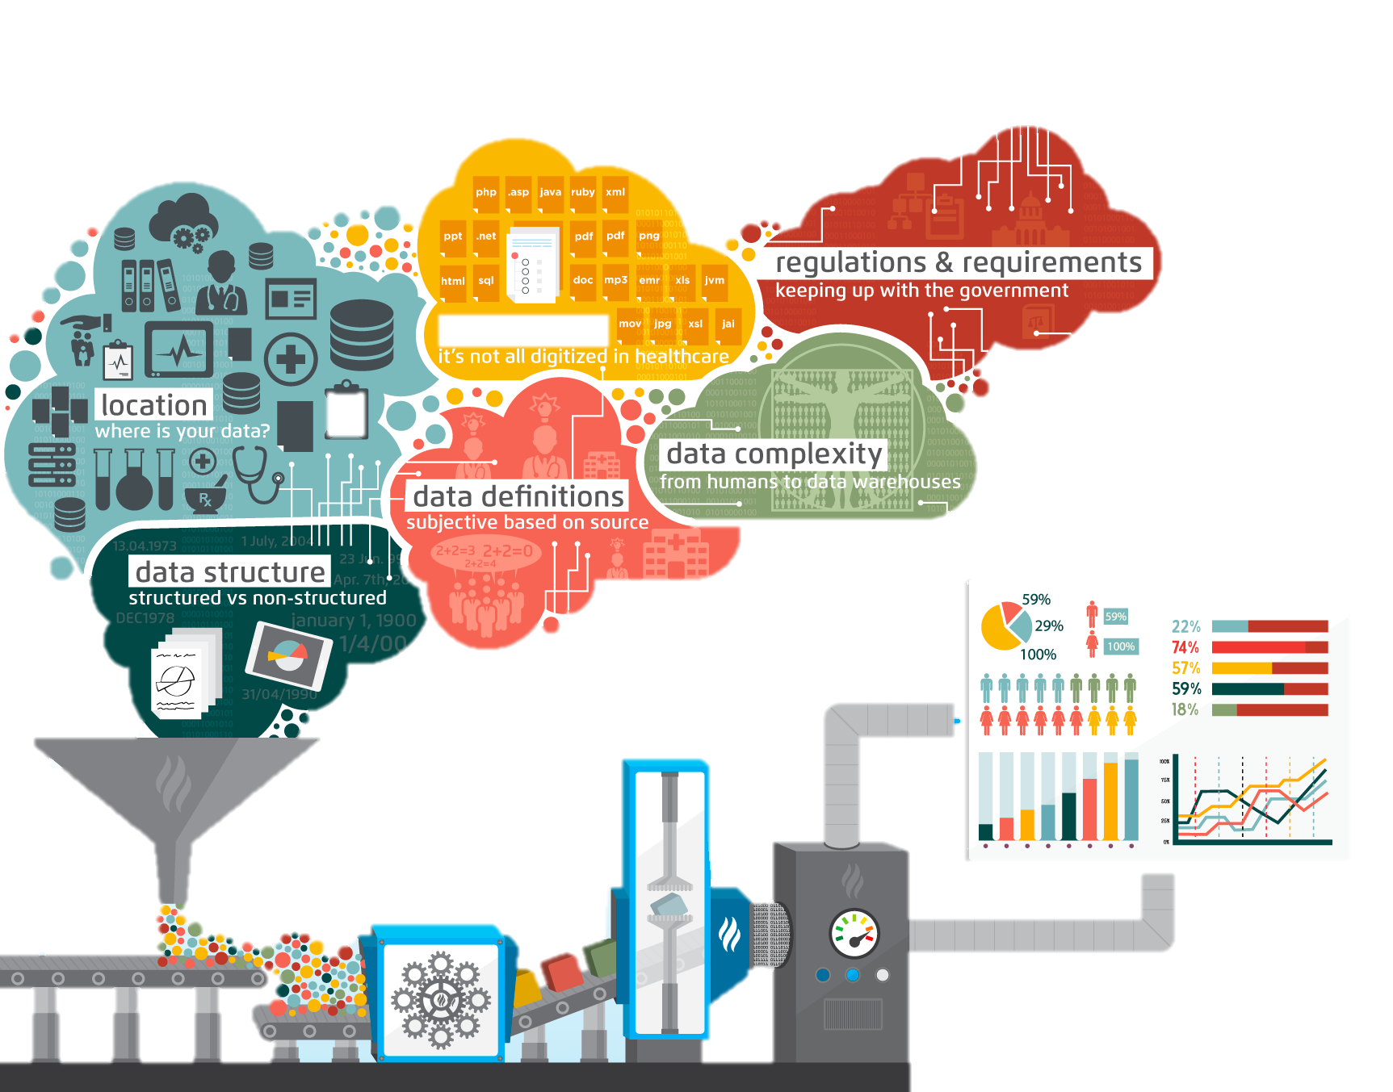

Clinical Research Networks
https://www.healthcatalyst.com/late-binding-data-warehouse/
Notes:
Talk about problems with these platforms
Healthcare faces major challenges when making sense of big data,
due to things like lack of standardization, government regulations
and data warehouse complexities

Slide 24
Chronic Obstructive Pulmonary Disease (COPD)
Acute Exacerbation
of COPD
(AECOPD)
Intensive Care Unit
(ICU)
diagnosis
classification
death
time
Notes:
progressive respiratory disease
characterized by inflammation and structural changes
decreased airflow
Symptoms: chronic cough, dyspnea, sputum production
Incurable lung disease, preventable, treatable
Leading population
4th leading cause of death U.S.
Effects roughly 65 million people worldwide
emphysema (damaged lung tissue) and chronic bronchitis (indicated by a frequent cough caused by excessive mucus production)
Billion$ on healthcare costs
https://stemcellthailand.org/therapies/copd-chronic-obstructive-pulmonary-disease/

Slide 25
4th
65 million
$50 billion
COPD
leading cause of death in the U.S.
people affected worldwide
hospitalizations are the greatest contributor
Notes:
Time matters!
Incurable lung disease, preventable, treatable
Leading population
4th leading cause of death U.S.
Effects roughly 65 million people worldwide
emphysema (damaged lung tissue) and chronic bronchitis (indicated by a frequent cough caused by excessive mucus production)
Billion$ on healthcare costs
https://stemcellthailand.org/therapies/copd-chronic-obstructive-pulmonary-disease/

Slide 26
Acute Exacerbation of COPD (AECOPD)
sudden worsening of symptoms
demands immediate action
Cause is hard to determine
major factor affecting mortality ⁷
“Exacerbations requiring hospitalization have a risk of mortality of approximately 10%.” ⁶
“The typical duration of therapy for AECOPD is 5 days.” ⁷
Notes:
we don't have enough time and time is important I see you is all about time and soul talk about time bringing out time
https://www.nebraskamed.com/sites/default/files/documents/for-providers/asp/COPD_pathway2016_Final.pdf
bacteria are known to cause exacerbations, there have been several trials conducted to determine if preventative antibiotics could decrease the exacerbation frequency and define the population that might derive greatest benefit from such therapy. Azithromycin has been studied as it has shown benefit in other pulmonary conditions

Slide 27

COPD Guidelines
1. Clinical Study
2. Analysis
5. Create Guidelines
3. Publish Results
4. Committee Discussion
Notes:
Limited info about hospitalized patients

Slide 28
“It is feasible to enhance representation of electronic health records to aggregate patients' entire medical histories and support complex clinical questions to drive clinical guidelines for chronic diseases.”
care-path
/ker paTH/
noun
noun: care-path; plural noun: care-paths
"a method for the patient-care management of a well-defined group of patients during a well-defined period of time.“ ^{[Vanhaecht 2007]}
“a detailed plan of care for a well-defined group of patients, which translates guidelines, evidence, and expert consensus opinion into local care and is a result of multidisciplinary work.” ^{[Lavelle 2015]}
3. “a chronological collection of events, occurring during a patient's hospital encounter.” ^{[Johnson 2018]}
Notes:
Explain what aggregate patients' entire medical histories means
Introduce care-path definition
Holistic view over time..
“Real patients, living in the real world are complex. They have comorbidities, environmental and behavioural factors as well as potential problems with adherence. Where there is a need for more rigorous scrutiny, real world data and audit can be used alongside the more established methods of value creation and pathway analyses.
Real world audits provide a better understanding of:
Patient cohort size and eligibility
Disease severity mix
Treatment patterns
Patient service access
Cohort or patient-level condition specific modelling
Healthcare professional experience
Patient reported outcomes
Patient reported experience”
clinical studies must limit their focus to common outcomes or treatments
EHR data may provide a richer patient profile than clinical study data where potential risks measured are pre-specified in the study protocol
Care Pathway: Clinical processes need to be designed to optimize the outcome for the patient. These are built based on empirical evidence in the practice of medicine.
Value: understanding a patients journey
Define CP
write about variations of CPs and their definitions
our CP is a reflection of actual treatments and outcomes
[encounter] = Treatments & outcomes are time points along the CP
can a pat raw data tell at what point in time a data point should be considered? or should the guidelines tell us?
basically, what are the rules for the care pathway?

Slide 29
What is the timing of initiation of antibiotics in COPD and impact on mortality?
Notes:
Talk about data loss
Capturing temporality
Timing of treatment

Slide 30
Research Objectives
Objective #1
Objective #2
Objective #3
Provide a novel framework
Generate care-paths with temporal trend
Apply computational methods to extract knowledge from care-paths for guidelines
Notes:
Taking time seriously
Time-series data have a natural temporal ordering and are typically not independent as the same individual is repeatedly measured, thus the data may exhibit some form of serial dependence or autocorrelation (i.e., the value of one observation depends, at least partly, on the value of one or more of the preceding observations in the series).
Talk about how objectives tie into the thesis statement
temporal event extraction associates clinical events with their corresponding time span or date
directly model the underlying temporal aspects of patient timelines
temporal diagnosis codes to produce patient representations over time
temporal matrix with time on one axis and events on the other

Slide 31
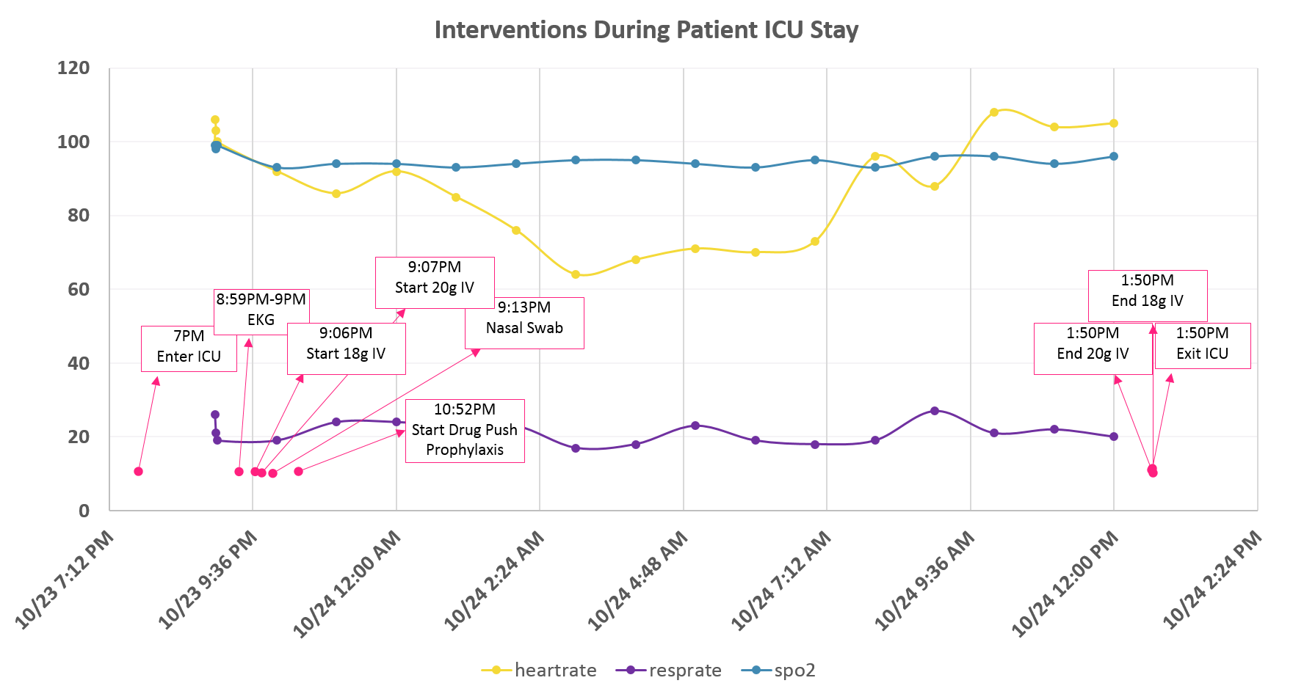
Care-paths
ICU: Admit
ICU: Discharge
ICU: Admit
ICU: Discharge
ICU: Admit
ICU: Discharge
ICU: Admit
ICU: Discharge
generate care-paths with temporal trend
ICU: Admit
ICU: Discharge
ICU: Admit
ICU: Discharge
ICU: Admit
Antibiotic
ICU: Discharge
ICU: Admit
ICU: Discharge
ICU: Admit
Antibiotic
ICU: Discharge
ICU: Admit
ICU: Discharge
RR 31
Antibiotic
RR 31
Antibiotic
Blood work
Vital Signs
RR 31
Antibiotic
Blood work
HR 94
RR 31
Blood Work
Blood work
HR 94
RR 31
Blood Work
Blood work
Urine sample
BP
HR 94
Blood Work
Blood work
Urine sample
BP
BP
HR 94
Blood Work
Urine sample
BP
Urine Sample
BP
HR 94
Blood Work
Urine sample
Oxygen
pH
BP
Urine Sample
BP
Temperature
Urine sample
Oxygen
pH
BP
Urine Sample
Oxygen
BP
HR 88
pH 8
Temperature
Oxygen
pH
Urine Sample
Discharge
Oxygen
BP
HR 88
pH 8
Temperature
MV
Oxygen
pH
Urine Sample
Discharge
Oxygen
HR 88
SP02
pH 8
Steroid
Temperature
Discharge
MV
Oxygen
pH
HR 88
SP02
pH 8
Steroid
Temperature
Oxygen
HR 104
pH 7.5
Discharge
MV
HR 88
SP02
pH 8
Steroid
Oxygen
HR 104
pH 7.5
Discharge
MV
SP02
Steroid
0
1
2
3
4
5
6
HR 104
7
8
9
pH 7.5
10
11
MV
SP02
Steroid
Time
0
1
2
3
4
5
6
HR 104
7
8
9
pH 7.5
10
11
Time
0
1
2
3
4
5
6
HR 104
7
8
9
pH 7.5
10
11
Time
0
0
1
1
2
2
3
3
4
4
5
5
6
6
7
7
8
8
9
9
10
10
11
11
Time
Time
Notes:
Objective #2 coincides w/our data analysis & viz layers

Slide 32
Modeling
No respiratory
failure
*ARF
non-life-threatening
*ARF
life-threatening
computational methods to extract knowledge for COPD treatment from care-paths of EHRs
Discharge
State transition diagram of exacerbation stages according to the GOLD classification of hospitalized patients
*ARF = Acute respiratory failure
Notes:
Talk about process and time to create this visual rep of a pat
Exacerbations: Classification of hospitalized patients
Software for machine learning
https://www.cs.ubc.ca/~murphyk/Teaching/CS540_Fall05/software.html

Slide 33
Data Infrastructure

Slide 34
Research to translation: big data in healthcare
Big Data Preprocess
Reproduce/Evidence Based Medicine/FDA Approval
High Performance Computing
Publication
Analysis/Code

Slide 35
Proposed architecture
Big Data
High Performance Computing
Analysis
Reproduce/Analysis
Publication
Publication
Evidence Based Medicine/FDA Approval

Slide 36
Multi-parameter Intelligent Monitoring in Intensive Care (MIMIC II)
MIMIC III
Clinical Database
Waveform Database
Matched Subset
58,000 Hospital Admission
2001-2012
Nurse entered physiology
Medications
Laboratory data
Nursing notes
Discharge notes
Format: CSV, SQL
~40GB
23,180 Records
2001-2012
Waveforms
ECG
Blood pressure
Plethysmography
Format: Text, Matlab
~3TB Compressed
4,897 Waveform and 5,266 Numeric records matched with 2,809 clinical records

Slide 37
Other Projects
Risk stratification for Stroke/AF
Classification of atrial fibrillation from ECG data.
Detection of hemorrhage from blood pressure data
Prediction of acute hypotensive episode
Characterizing the factors and outcomes for use of antipsychotics in patients with delirium

Slide 38
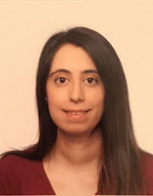
Collaboration with Fellows
Marvi Bikak
Fellow School of Medicine Indiana University

